Slide 1

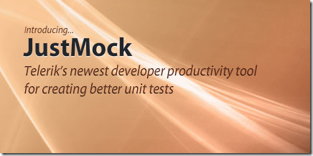
Mocking with Moq and JustMock
Mocking tools for easier unit testing
High Quality Code
Telerik Software Academy
http://academy.telerik.com

Slide 2

Table of Contents
Testable Code
Mocking
Moq
Moq demo
JustMock
JustMock demo

Slide 3
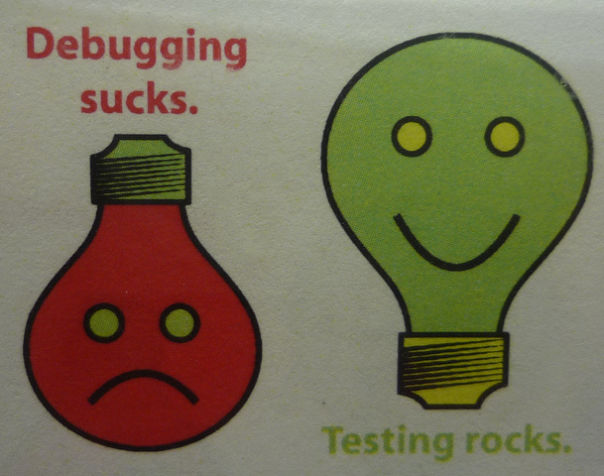
Testable Code

Slide 4
How to Write Testable Code
Inversion of Control Pattern
There is a decoupling of the execution of a certain task from implementation
Every module can focus on what it is designed for
Modules make no assumptions about what other systems do but rely on their contracts
Replacing modules has no side effect on other modules
More info at http://en.wikipedia.org/wiki/Inversion_of_control

Slide 5
How to Write Testable Code
Public API should work with interfaces, not implementation classes (IEnumerable vs. List)
Bad code:
Good code:
public Card[] Cards { get; private set; }
public IList<ICard> Cards { get; private set; }

Slide 6
How to Write Testable Code
Dependency Injection
Ninject – http://www.ninject.org/
Consists of:
A dependent consumer
A declaration of a component's dependencies, defined as interface contracts
An injector (sometimes referred to as a provider or container) that creates instances of classes that implement a given dependency interface on request

Slide 7
How to Write Testable Code
Bad:
public interface IViewBase {}
public interface IPresenterBase {}
public class MemoryLayoutView: IViewBase {}
public class MemoryLayoutPresenter: IPresenterBase
{
private MemoryLayoutView view = new MemoryLayoutView();
public MemoryLayoutPresenter() { }
}

Slide 8
How to Write Testable Code
Good:
public interface IViewBase {}
public interface IPresenterBase {}
public class MemoryLayoutView: IViewBase {}
public class MemoryLayoutPresenter : IPresenterBase
{
private IViewBase view;
public MemoryLayoutPresenter(IViewBase myView)
{
this.view = myView;
}
}
public class Program {
static void Main() {
InjectionContainer.Create<typeof(MemoryLayoutPresenter)>();
}
}

Slide 9

Mocking

Slide 10
Mocking
Makes Unit Testing more effective
Avoid writing boring boilerplate code
Isolate dependencies among units
Asserts expectations for code quality
Ex: Checks that a method is called only once

Slide 11

Moq

Slide 12
Moq
Install from the NuGet package manager
Refer the library
Use its API
https://github.com/Moq/moq4
var mock = new Mock<ICarsRepository>();
mock.Setup(r => r.Add(It.IsAny<Car>())).Verifiable();
mock.Setup(r => r.All()).Returns(this.FakeCarCollection);

Slide 13
Moq
The most often used APIs:
.Setup()
.Verifiable()
.Callback()
.Returns()
.Throws()
It.Is<type>(x => condition)

Slide 14
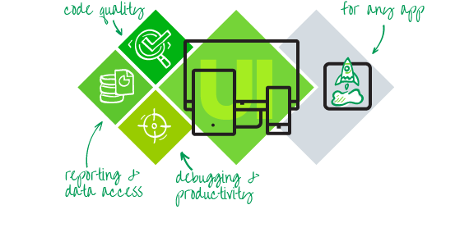
Telerik JustMock

Slide 15
Telerik JustMock
Install from the Telerik account
http://www.telerik.com/products/mocking.aspx
Use the Visual Studio NuGet package manager
CarsData = Mock.Create<ICarsRepository>();
Mock.Arrange(() => CarsData.Add(Arg.IsAny<Car>())).DoNothing();
Mock.Arrange(() => CarsData.All()).Returns(FakeCarCollection);
Mock.Arrange(() => CarsData.Search(Arg.AnyString))
.Returns(FakeCarCollection.Where(
c => c.Make == "BMW").ToList());
Mock.Arrange(() => CarsData.GetById(Arg.AnyInt))
.Returns(FakeCarCollection.First());

Slide 16
Telerik JustMock
Two versions:
Free version – excellent when the code is written with testability in mind
Paid version – mocks everything (mscorlib, EntityFramework, SQL), legacy code base which is not written to be testable, statics, privates, etc.
More information here:
http://www.telerik.com/help/justmock/getting-started-commercial-vs-free-version.html

Slide 17
Telerik JustMock
The most often used APIs:
.CallOriginal()
.Returns()
.DoInstead()
.DoNothing()
.Throw()
Arg.Matches<type>(x => condition)

Slide 18

Mocking
Live Demo

Slide 19
Mocking with Moq and JustMock
http://academy.telerik.com

Slide 20
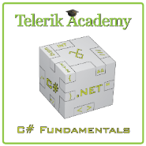



Free Trainings @ Telerik Academy
C# Programming @ Telerik Academy
csharpfundamentals.telerik.com
Telerik Software Academy
academy.telerik.com
Telerik Academy @ Facebook
facebook.com/TelerikAcademy
Telerik Software Academy Forums
forums.academy.telerik.com

